Slide 1
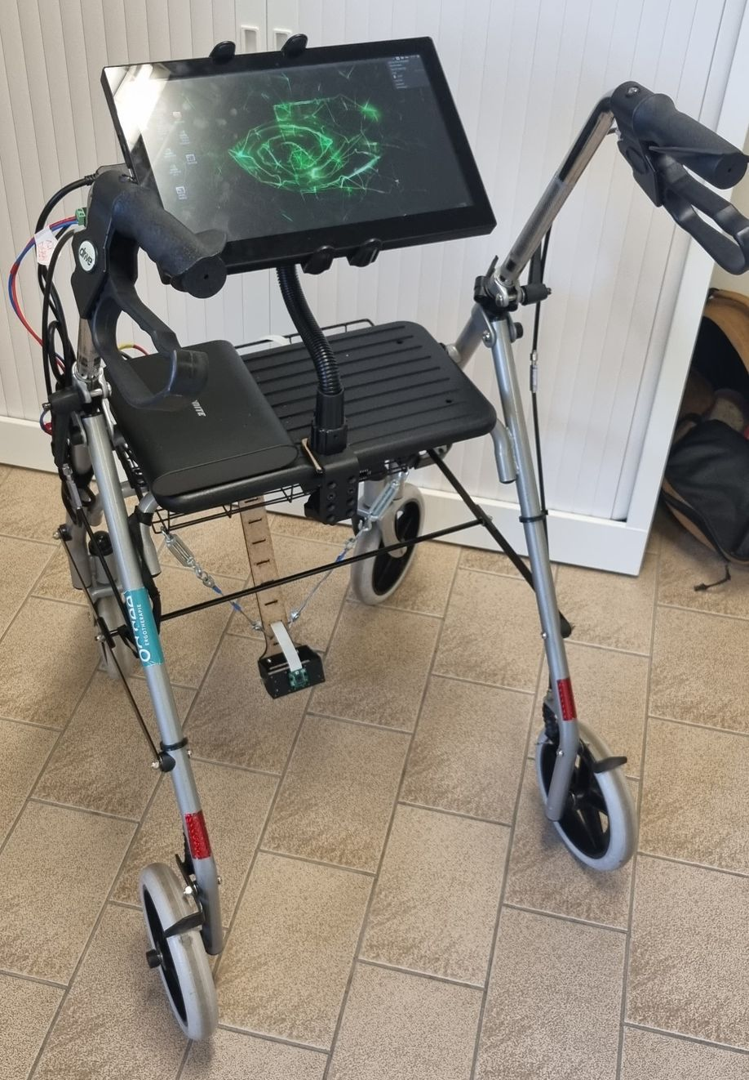
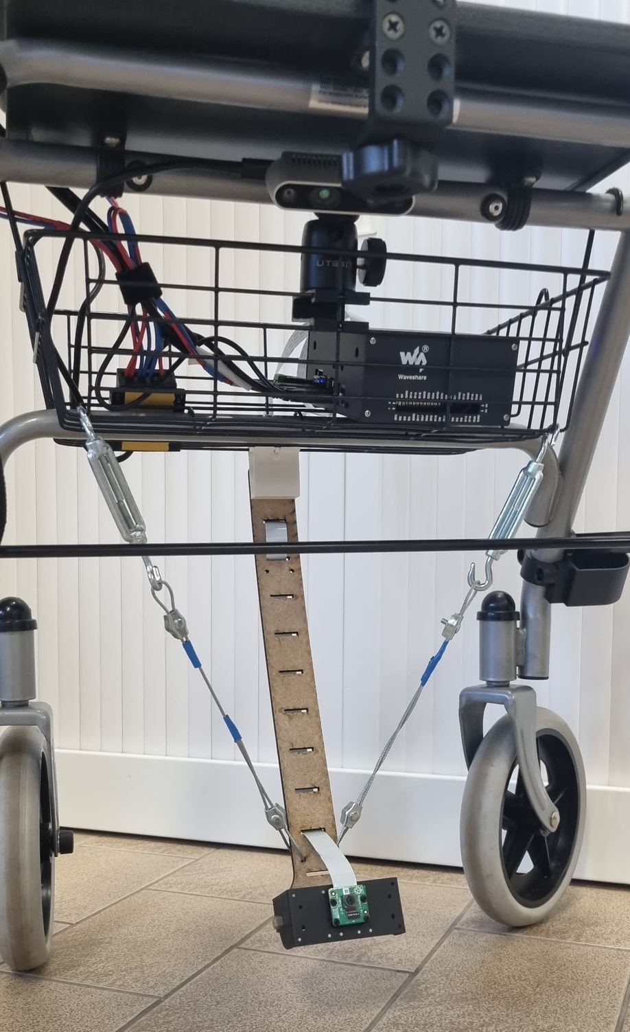
Smart walker
Debeuf Ruben & Feyen Karen
Notes:
Rollator kaderen m.b.t. wat op de markt is en hoe deze rollator verschilt van reeds bestaande rollators

Slide 2
Smart walker Timeline
Brainstorm sessions with working group
April – May 2021
Focus group discussions

Slide 3
Focus group discussions
4 discussions
Occupational therapists
Physiotherapists
Nurses
Physicians
…
Auditive feedback - step rhythm
Visual feedback – gait pattern
Low cost
Debeuf, R., Fobelets, M., Vaneyghen, J., Naets, B., Minnaert, B., De Wachter, E., Lambrechts, R., Beckwée, D., Jansen, B., Middag, C., Swinnen, E. Healthcare professionals’ perspectives on development of assistive technology using the Comprehensive Assistive Technology model – Resubmitted after minor revisions (February 2023) in Assistive Technology.

Slide 4
Smart walker Timeline
Brainstorm sessions with working group
June 2021 – June 2022
Development and applications
April – May 2021
Focus group discussions

Slide 5
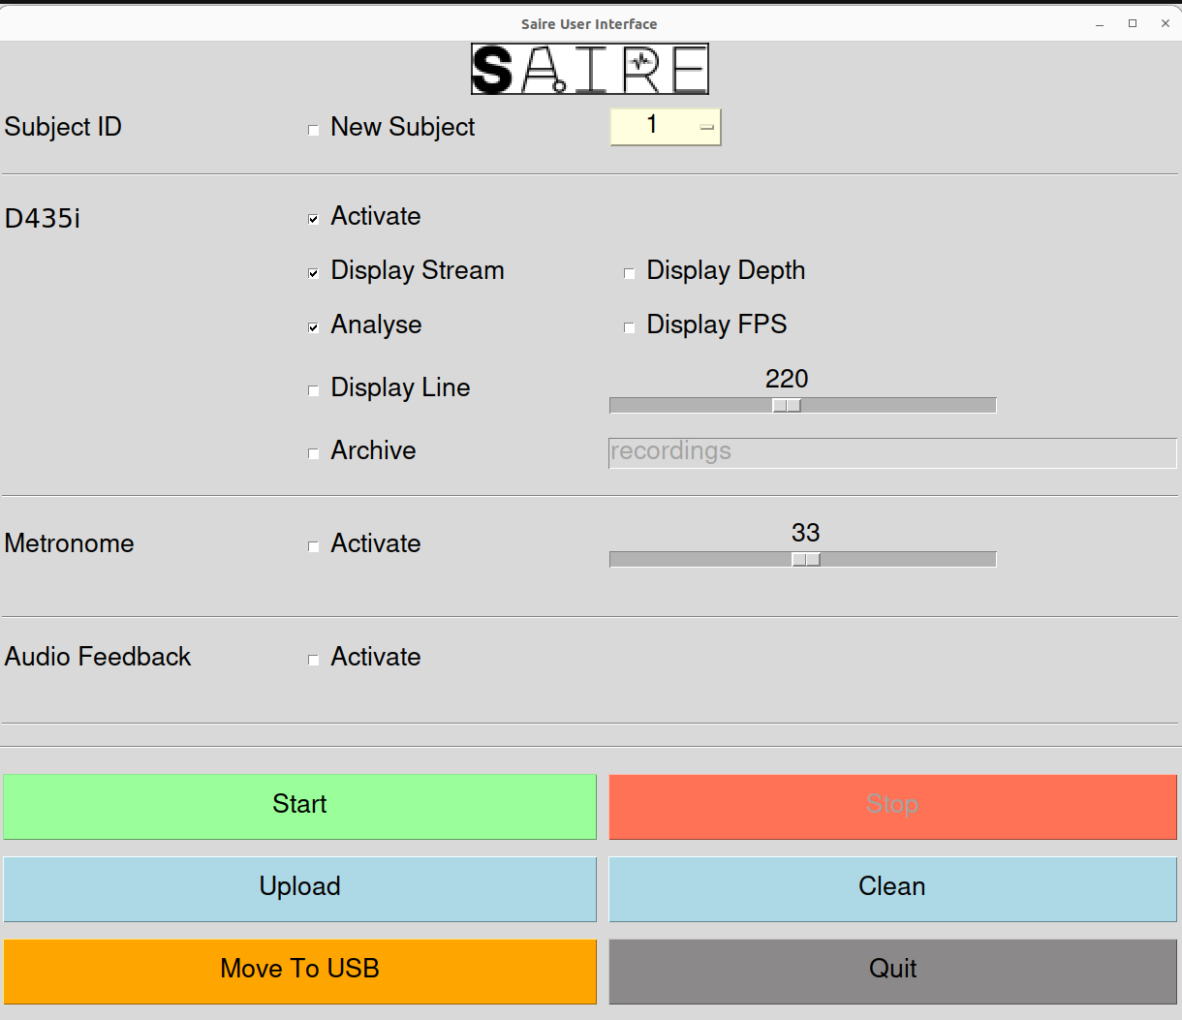
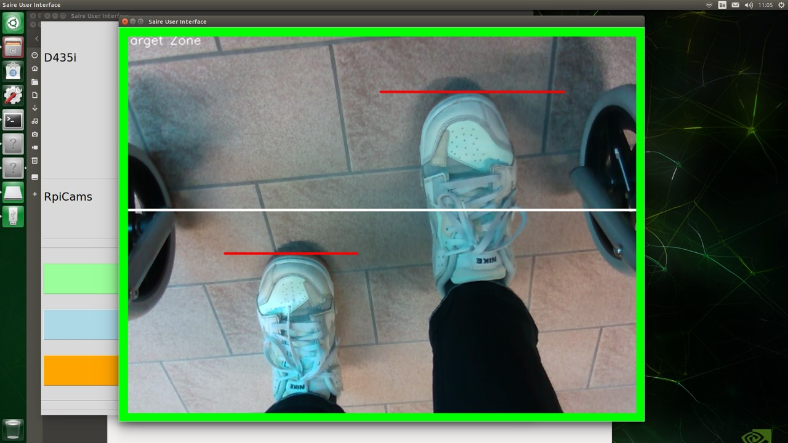
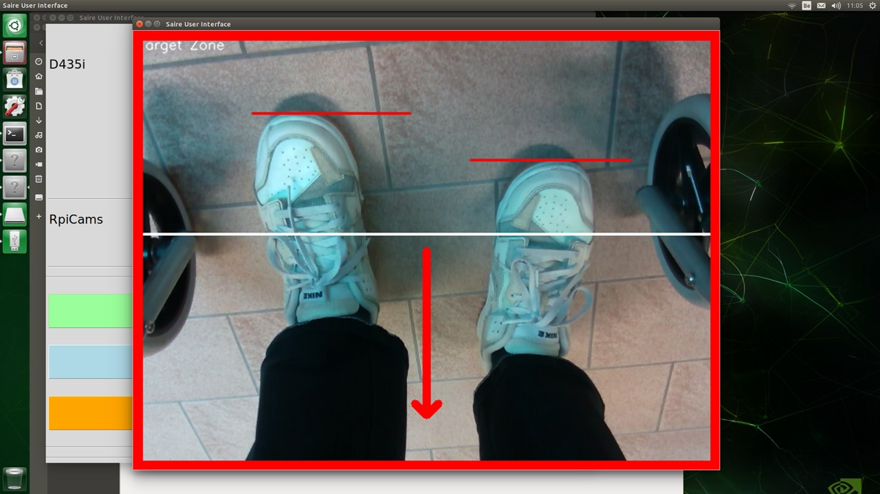
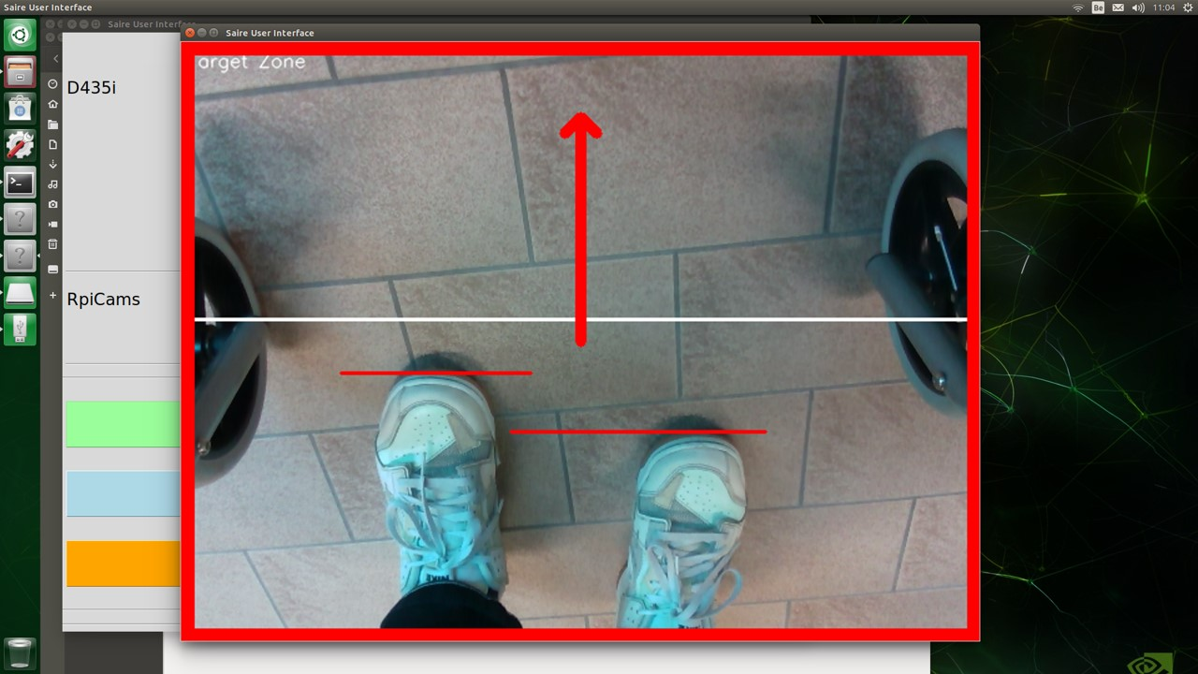
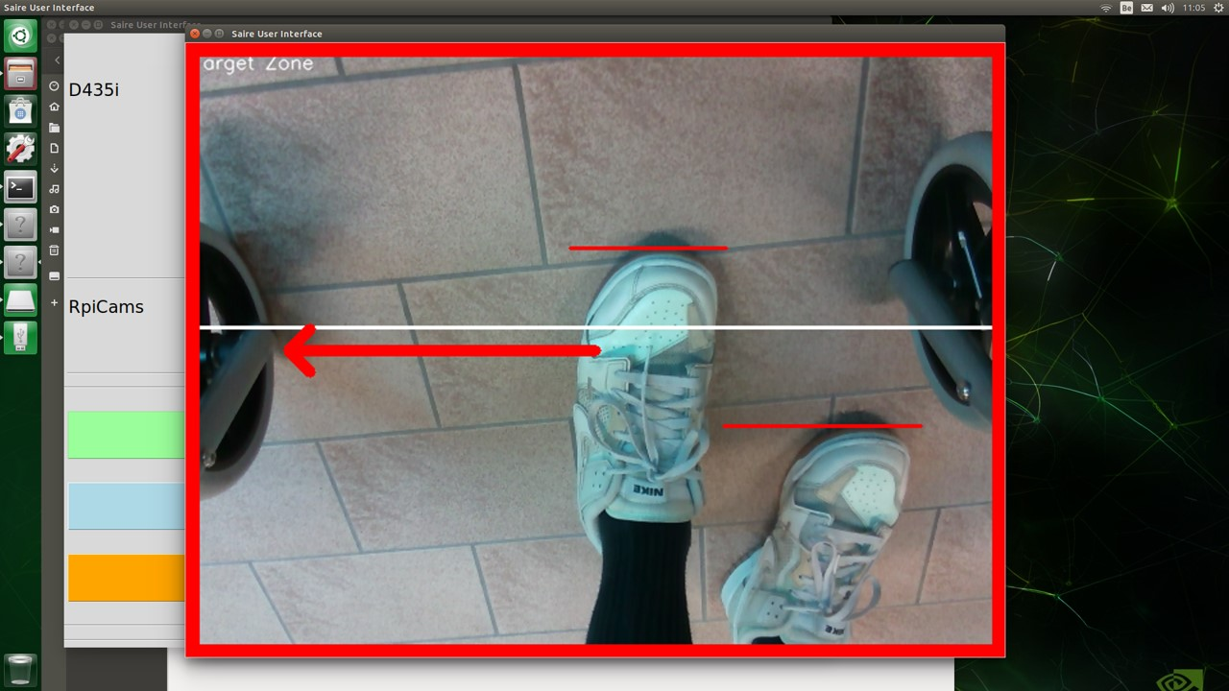
Smart walker

Slide 6
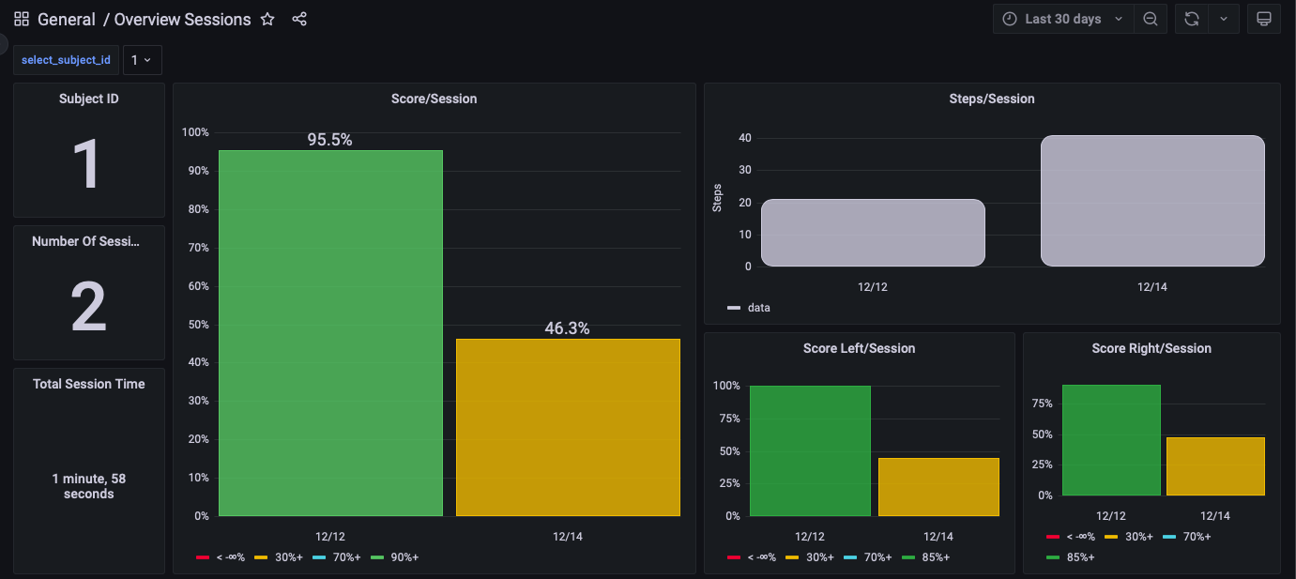
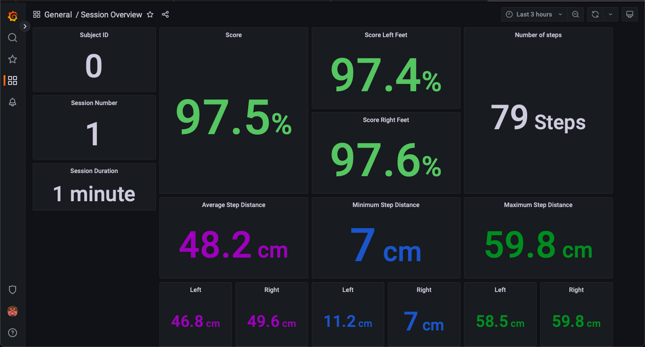
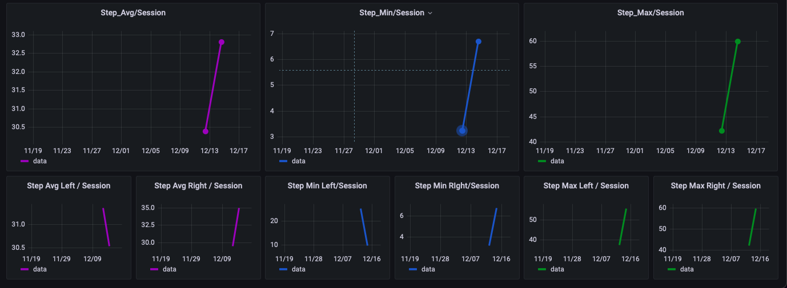
Smart walker
Overview multiple sessions
percentage of correct steps
One session
L
R

Slide 7
Smart walker Timeline
Brainstorm sessions with working group
June 2021 – June 2022
Development and applications
April – May 2021
Focus group discussions
September 2022 - …
Recruitment, clinical trials, analysis

Slide 8
Participants
Inclusion criteria:
18+
Ability to walk a 10-meter walkway multiple times over a period of 120 minutes
Benefits from use of any sort of assistive device during walking (e.g., cane, crutches, walker, etc.)
Sufficient arm/hand function to walk with a walker
Exclusion criteria:
Presence of cognitive impairment

Slide 9
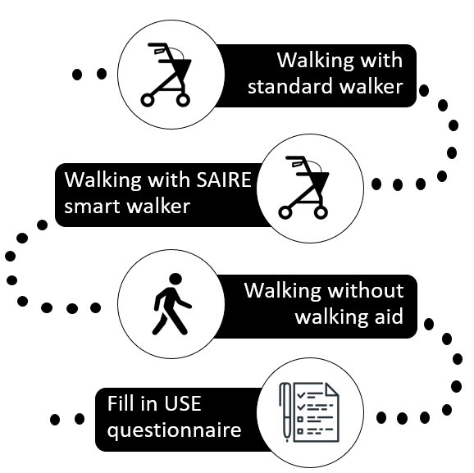
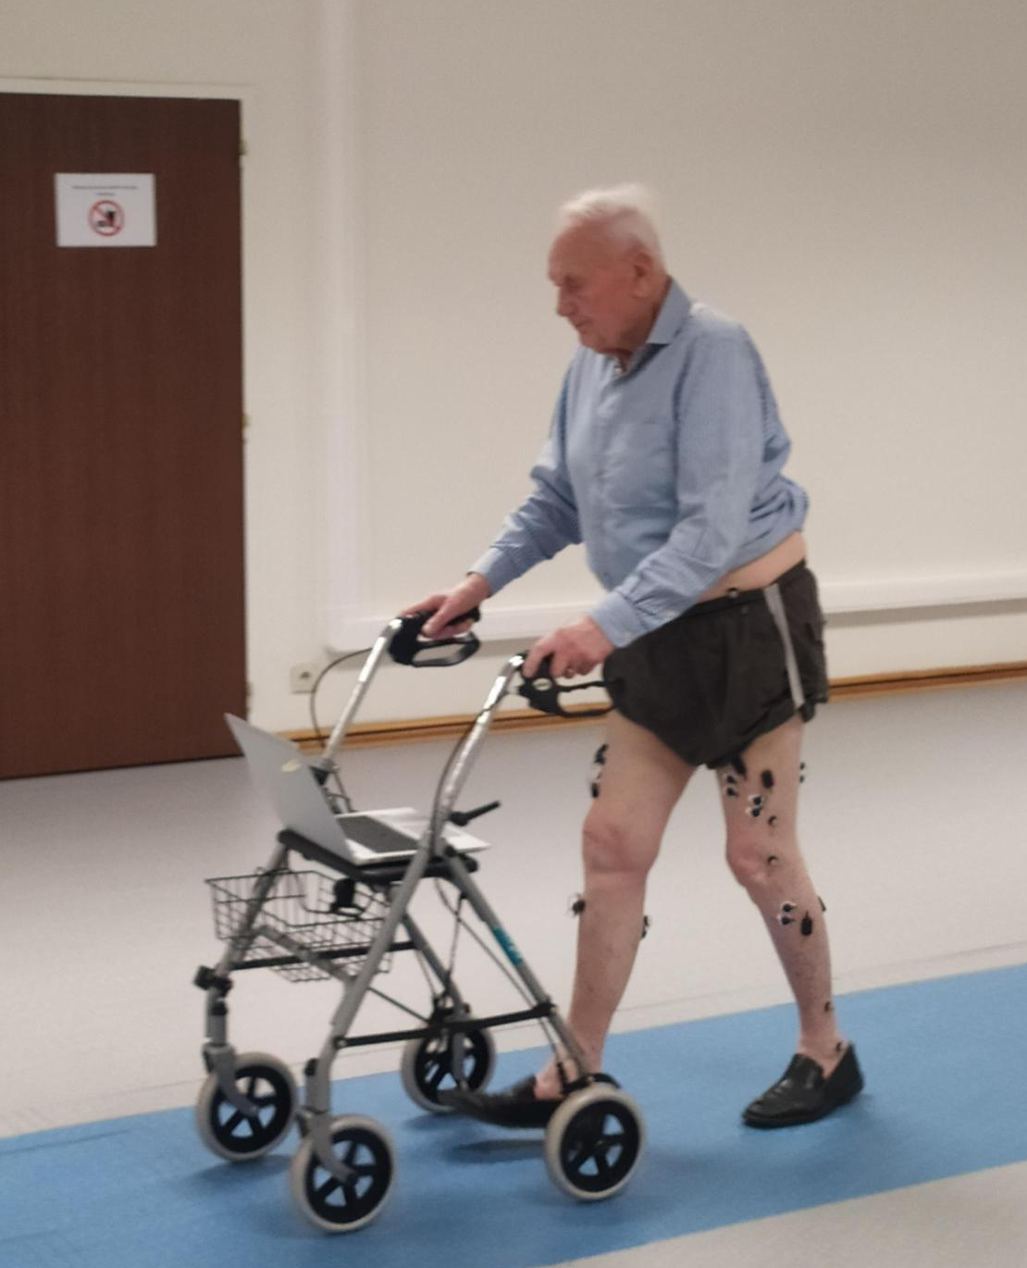
Clinical trial
Experimental session
Outcomes
Spatiotemporal gait parameters of the lower limb during walking
Kinematic data of the lower limb during walking
Muscle activity of the lower limb during walking
User experience
Notes:
!! Benadrukken over welke outcomes we al iets kunnen zeggen, de andere data zijn we nog aan het analyseren

Slide 10
Preliminary results
Characteristics of participants (n= 13)
Sex (n,%) | Male | 3 (23.1%)
 | Female | 10 (76.9%)
Age (mean yrs ± SD) |  | 77,9 ± 11.9
Length (mean cm ± SD) |  | 162.9 ± 12.3
Weight (mean kg ± SD) |  | 74.3 ± 11
Walking aid (n,%) | Walker | 4 (30.8%)
 | Cane | 3 (23.1%)
 | Crutches | 3 (23.1%)
 | No walking aid, but balance problems | 3 (23.1%)

Slide 11
Preliminary results Spatiotemporal parameters
 | Standard walker | Smart walker
Participants (n) | 12 | 12
Walking speed (m/s) | 0.77 ± 0.19 | 0.76 ± 0.22
Cadence (steps/min) | 92.42 ± 13.85 | 92.39 ± 18.61
Step length (m) | 0.50 ± 0.09 | 0.49 ± 0.09
Stride length (m) | 0.99 ± 0.18 | 0.98 ± 0.18
Step width (m) | 0.16 ± 0.04 | 0.16 ± 0.05
Continues values expressed as mean ± standard deviation
step length
stride length
step width
support phase
swing phase
Notes:
Testen of mensen beter stappen als ze er een keer mee stappen, zoals weergegeven in de tabel is geen verschil tussen beide zichtbaar. Voor ons is het hier relevant dat er geen extra last op de gebruiker wordt gelegd (patiënten wandelen niet trager of nemen geen kleinere stappen). Onze verwachtingen zijn dat patiënten naarmate ze meerdere keren trainen met de walker verwachten we wel een verschil te zien tussen beide condities.

Slide 12
Preliminary results User experience
Usability, satisfaction and ease of use questionnaire
Usefulness
Ease of use
Ease of learning
Satisfaction
 | 1 | 2 | 3 | 4 | 5 | 6 | 7
Strongly disagree |  |  |  |  |  |  |  | Strongly agree
Notes:
Gevalideerde vragenlijst die 32 vragen heeft die de 4 topics ..

Slide 13
Preliminary results User experience
Mean scores for every subcategory (/7)
Mean + standard deviation
Mean score
Mean - standard deviation
Usefulness
Ease of use
Ease of learning
Satisfaction
Notes:
Ergens vermelden dat het op 7 is

Slide 14
Preliminary results User experience
Rating of different subcategories, indicating the number of subjects agreeing or disagreeing with the statements
7: Strongly agree
6
5
4
3
2
1: Strongly disagree

Slide 15
Preliminary results User experience
Rating of different subcategories, indicating the number of subjects agreeing or disagreeing with the statements
7: Strongly agree
6
5
4
3
2
1: Strongly disagree

Slide 16
Preliminary results User experience
Rating of different subcategories, indicating the number of subjects agreeing or disagreeing with the statements
7: Strongly agree
6
5
4
3
2
1: Strongly disagree

Slide 17
Preliminary results User experience
Rating of different subcategories, indicating the number of subjects agreeing or disagreeing with the statements
7: Strongly agree
6
5
4
3
2
1: Strongly disagree

Slide 18
Preliminary results User experience
What elements would you add to the walker?
Further develop the feedback system
Adjustable front wheels capable of riding up boardwalks
What elements would you remove from the walker?
Audio feedback is not necessary
Are there any elements that you would change?
Might be a bit to complex for people with early stages of dementia

Slide 19
Smart walker Timeline
Brainstorm sessions with working group
June 2021 – June 2022
Development and applications
April – May 2021
Focus group discussions
September 2022 - …
Recruitment, clinical trials, analysis

Slide 20
QUESTIONS?

